Slide 1
Gender Friendly and Inclusive Approaches on WASH in HCFs
Presenter :
Chet Narayan Kafle – Senior AHW
Jamuni Health Post, Badaiyatal Rural Municipality

Slide 2
Jamuni Health Post - Background
Jamuni HP is located in Badiyatal Rural Municipality.
Established in 2050 B.S.
OPD cases per day is 40- 50 patient
Birthing cases – 13-15 delivery per month

Slide 3
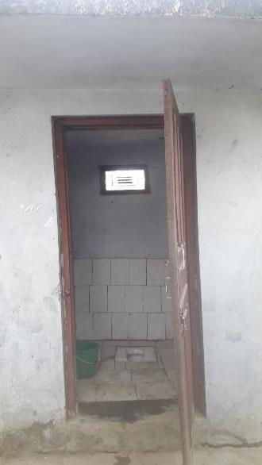
Pre-intervention WASH facilities
One Tube well used for drinking and hand washing
Only one toilet available for patient and staffs

Slide 4
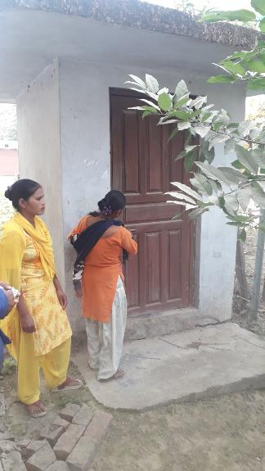
Pre-intervention WASH facilities
Limited WASH facilities available

Slide 5
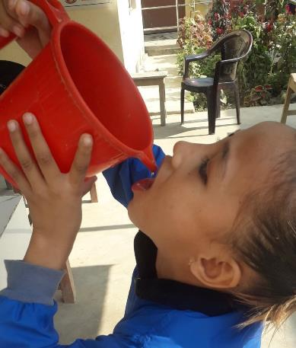
Post-Intervention of WASH facilities
Newly installed drinking water facility

Slide 6
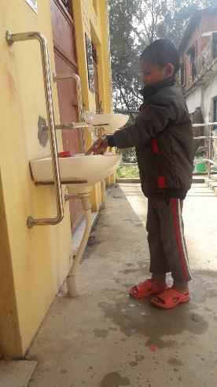
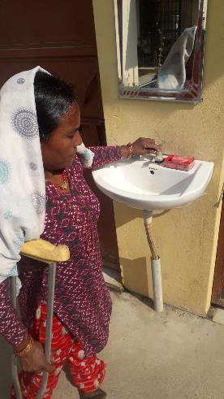
Post-Intervention of WASH facilities
CGD friendly hand washing stations

Slide 7
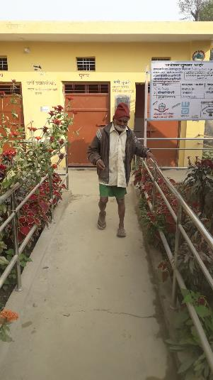
Post-Intervention of WASH facilities
Inclusive toilet block with ramp
10-12 December 2019

Slide 8
Post-Intervention of WASH facilities
Inclusive toilet

Slide 9
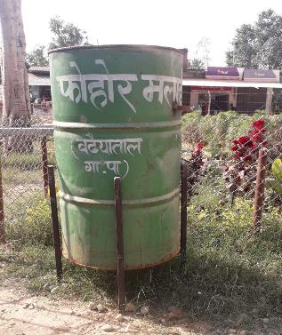
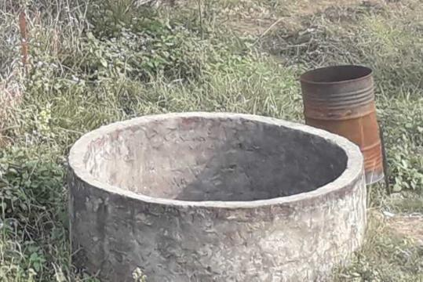
Challenge: Healthcare Waste Management

Slide 10
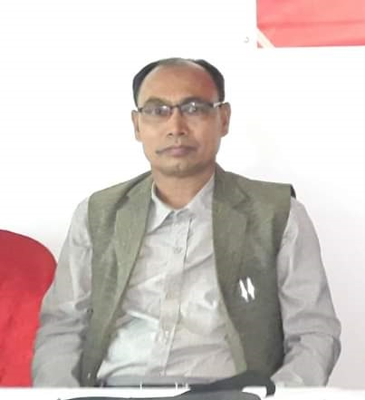
Voices from the Rural Municipal Chairperson
Badhaiyataal Rural Municipality Chairperson Mr. Lal Bahadur Shrestha said that, “Jamuni health post is the best in my municipality. I am committed to ensure quality health care facilities and support national target to achieve its SDG targets”.

Slide 11
Post-Intervention of WASH facilities
Thank you
Children using hand washing station

